Slide 1
OCR
New 6th form accreditation

Slide 2
6th form are now running a new *fully accredited timetable.
Life and Living skills
Functional skills – numeracy
Functional skills - literacy
Why change?
Choice: 150 units. (LLS)
Variety: wide range of skill areas.
Linked to KS4.
Flexible: spiky profile units.
Appropriate for 6th form.
‘Varied personalised learning programmes with a flexible structure.’

Slide 4
Options
LG1/2 have options.
LG3/4 (will have options in the future)
Monitoring
See spread sheets

Slide 5
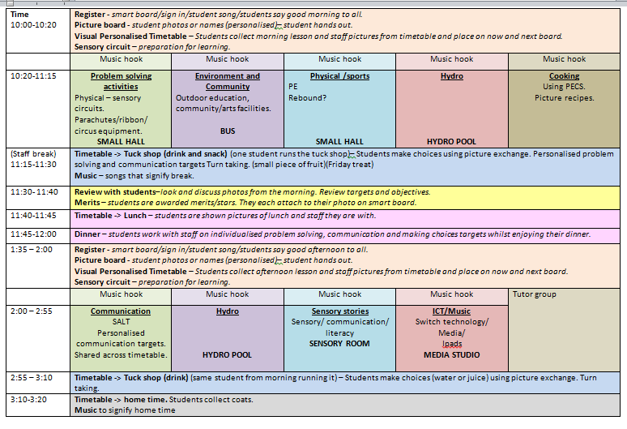
LG5

